Slide 1
Document detection using CNNs
Shifting R&D from hand-crafted to data-driven
Martin Stämmler
Expense Reader
29/11/2018, Munich
265ced1609a17cf1a5979880a2ad364653895ae8
Notes:
Cover example with no photos
Please insert the other company’s logo in the same size as the Amadeus logo, with no background and reverse out colour

Slide 2
Agenda
Document scanning on mobile
Previous approach to CV problems
New data-driven solution (2 approaches)
265ced1609a17cf1a5979880a2ad364653895ae8

Slide 3
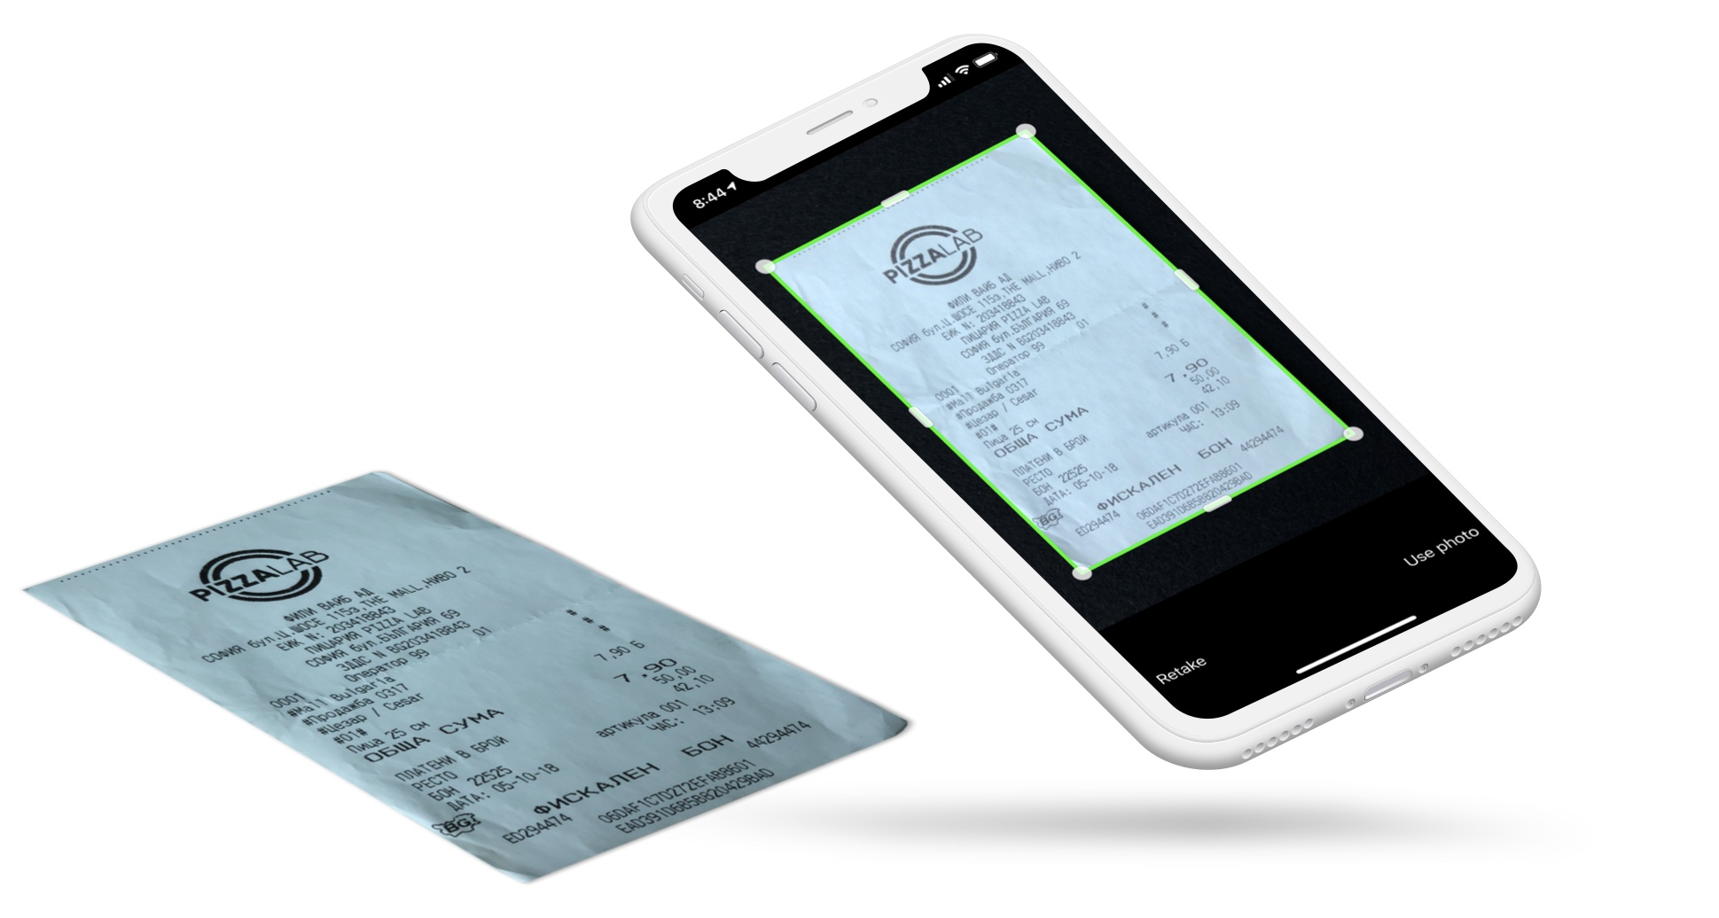
Expense Reader Scan SDK
Helps business travellers using cytric Mobile
scan their expense receipts
cytric Mobile
+ Expense Reader Scan SDK
iOS + Android
expense receipt
hotel, taxi, lunch, …
from all over the world
265ced1609a17cf1a5979880a2ad364653895ae8
Notes:
To update the text, just click on the text
More slides with this layout: Copy slide and paste

Slide 4

Expense Reader Scan SDK
Demo video:
scan feature in cytric Mobile
guides the user while scanning
produces a clean digital document
Expense Reader API
performs OCR and extracts data
pre-fill expense form
265ced1609a17cf1a5979880a2ad364653895ae8
Notes:
To update the text, just click on the text
More slides with this layout: Copy slide and paste

Slide 5
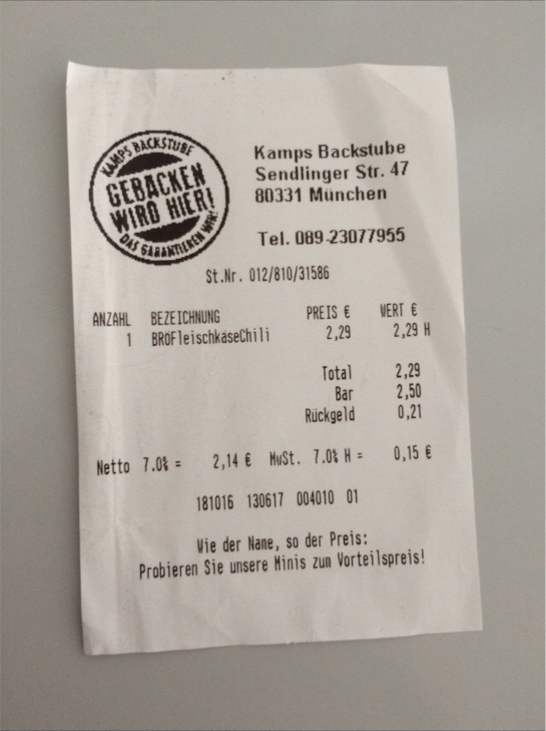
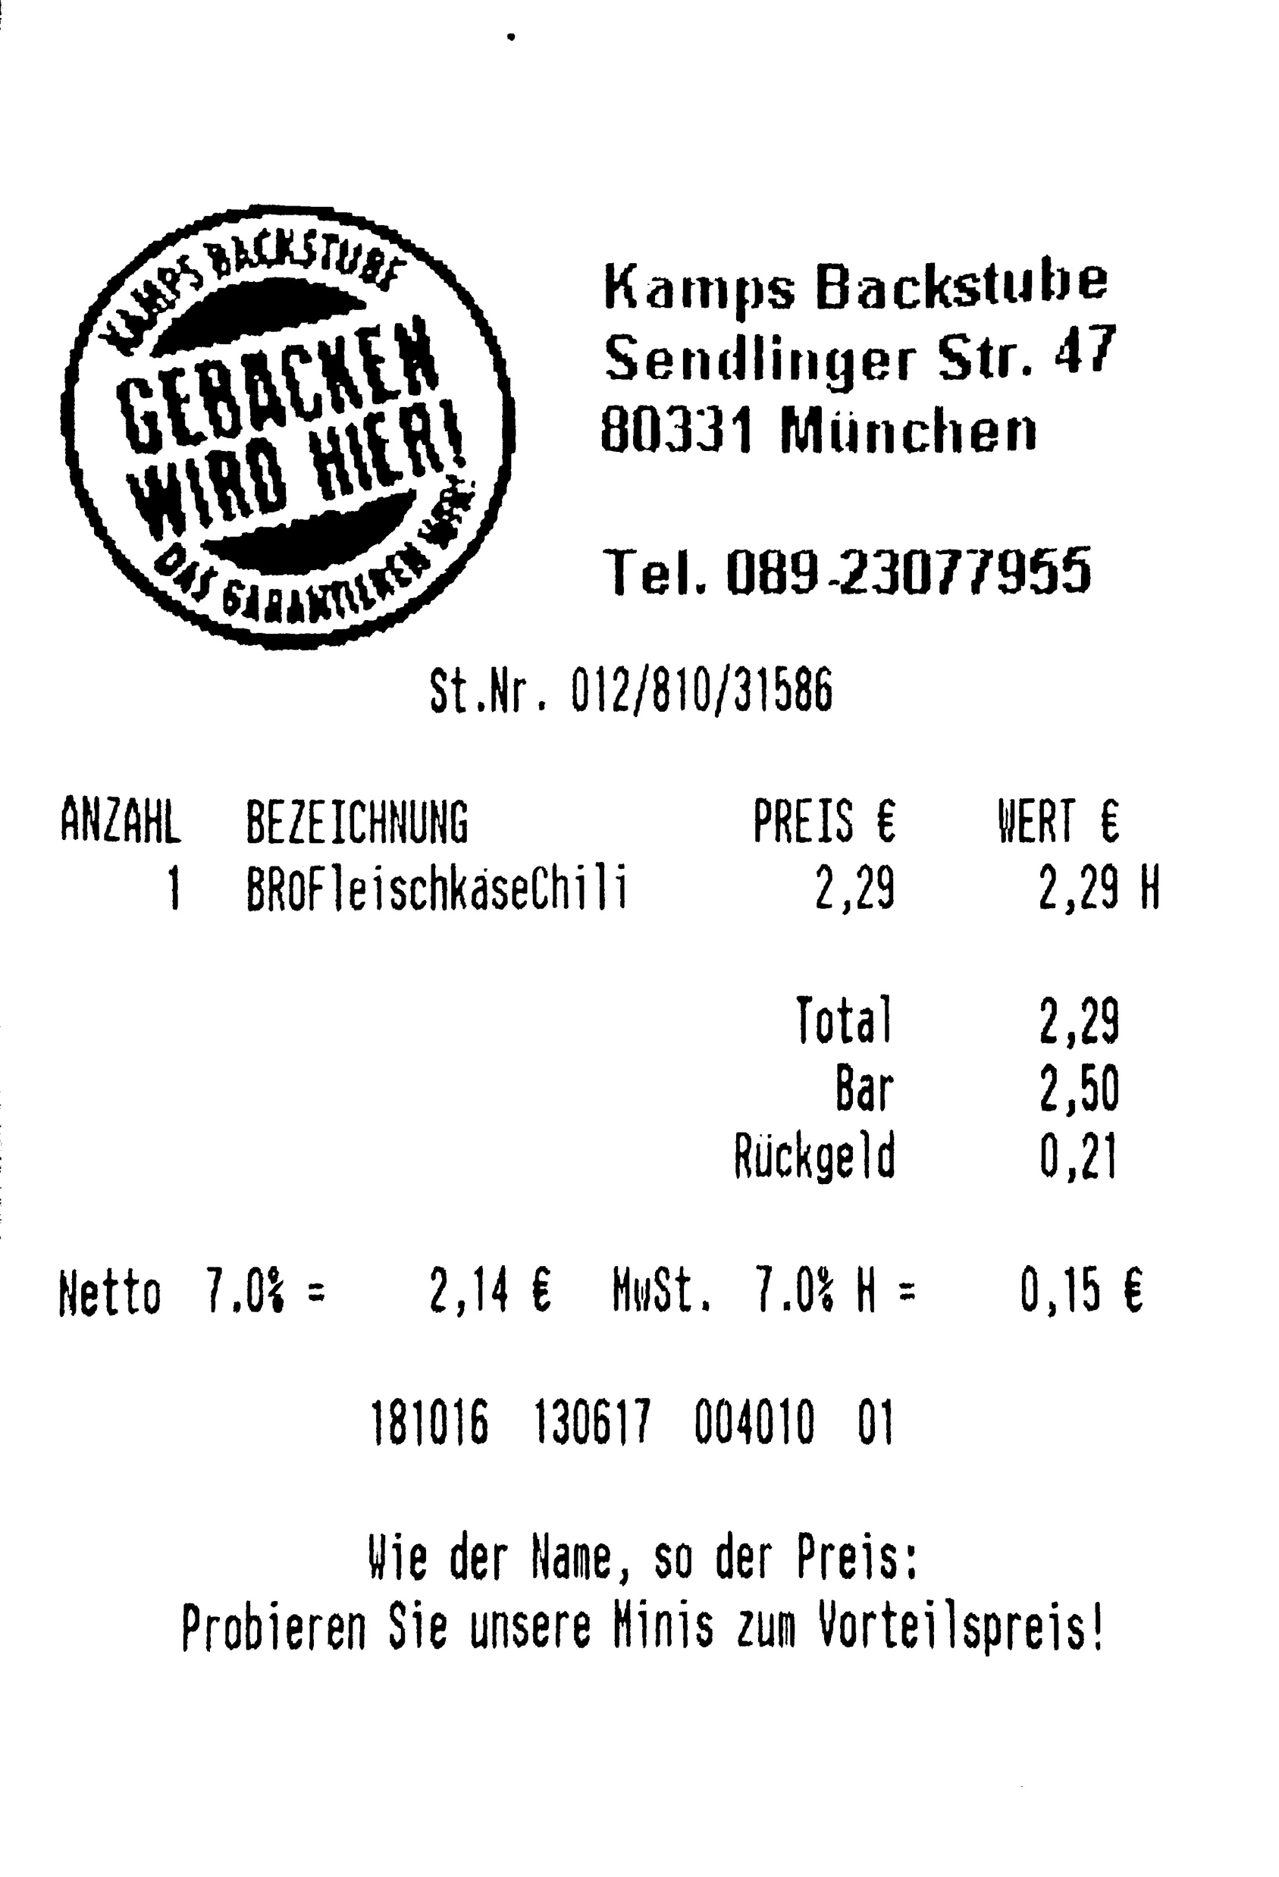
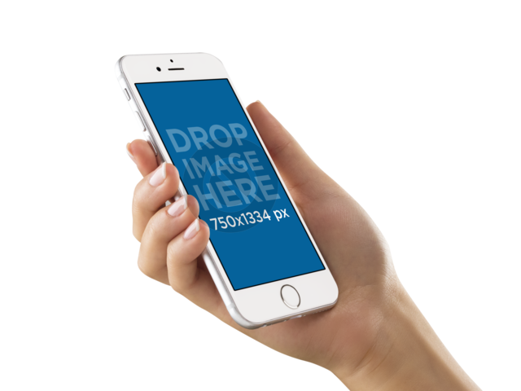
Expense Reader Scan SDK
What exactly is the job of mobile scan technology?
Mobile Scan
Technology
photo of a document
scan image
(cropped, clean, suitable for OCR)
265ced1609a17cf1a5979880a2ad364653895ae8
Notes:
To update the text, just click on the text
More slides with this layout: Copy slide and paste

Slide 6
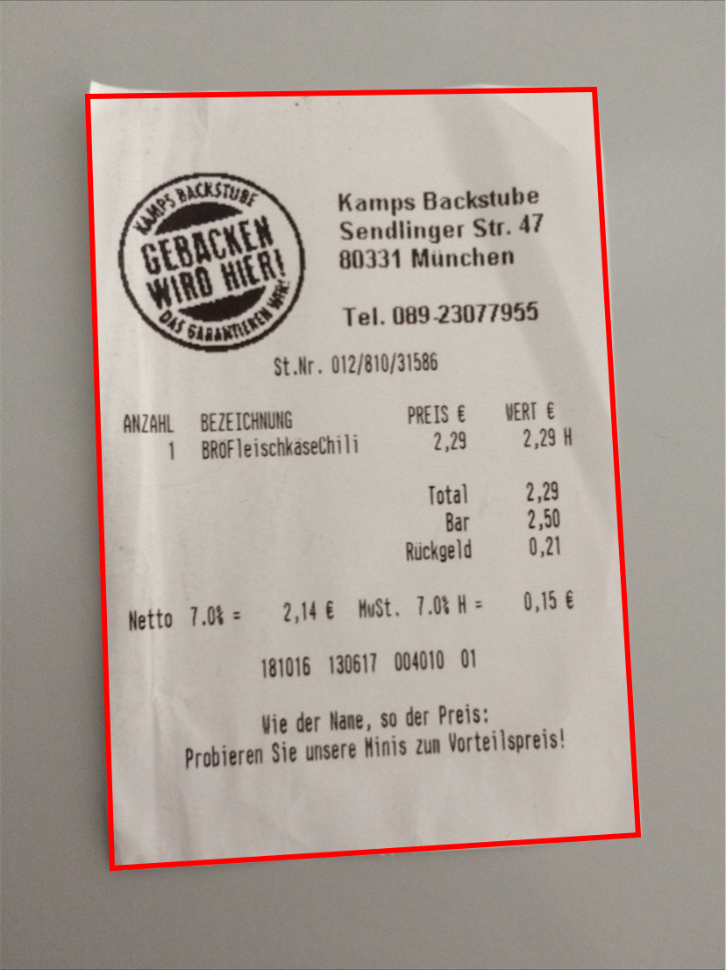
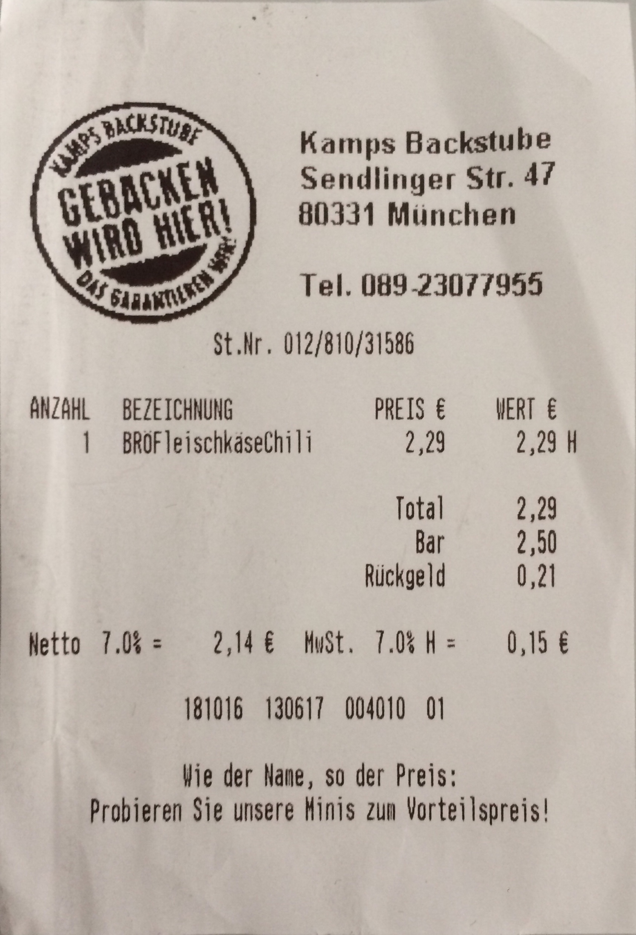
Expense Reader Scan SDK
Problem to solve: “frame detection”
guide the user in real-time while taking a photo
crop & do perspective correction
tell when to scan & where to crop
photo or video of document
with detected frame
homography warp
crop & perspective correction
265ced1609a17cf1a5979880a2ad364653895ae8
Notes:
To update the text, just click on the text
More slides with this layout: Copy slide and paste

Slide 7
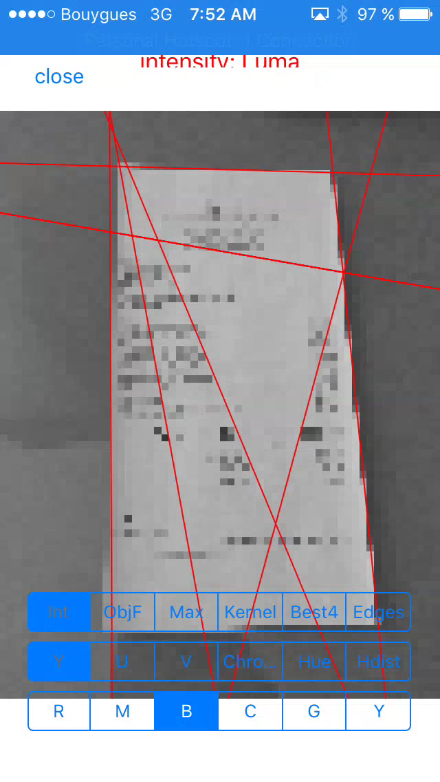
Previous approach
Hand-crafted frame detection
Methods & Technology:
edge detection
Hough transform
non-max suppression
local maxima
lots of geometry & linear algebra
Accelerate (iOS), RenderScript (Android)
detection accuracy
48.75% (original algorithm)
54.12% (after a major refactoring)
Difficulties:
algorithms are very difficult to implement and to maintain
lots of computer vision expert knowledge required
real-time capable implementation with platform-specific optimizations for iOS and Android
compatibility with a wide range of devices
“that’s not possible mentality” due to assumptions and simplifications in the model
265ced1609a17cf1a5979880a2ad364653895ae8
Notes:
To update the text, just click on the text
More slides with this layout: Copy slide and paste

Slide 8


New data-driven solution
Can’t we do all that with Machine Learning?
Plan:
don’t try to improve the solution with more special knowledge (because it doesn’t scale well)
instead, figure out how to reformulate the problem in terms of a Machine Learning model
gather data (lots of input + output)
understand in general how to train a ML model properly
understand in general how to get a ML model running in iOS and Android, avoid custom implementations
265ced1609a17cf1a5979880a2ad364653895ae8
Notes:
To update the text, just click on the text
More slides with this layout: Copy slide and paste

Slide 9
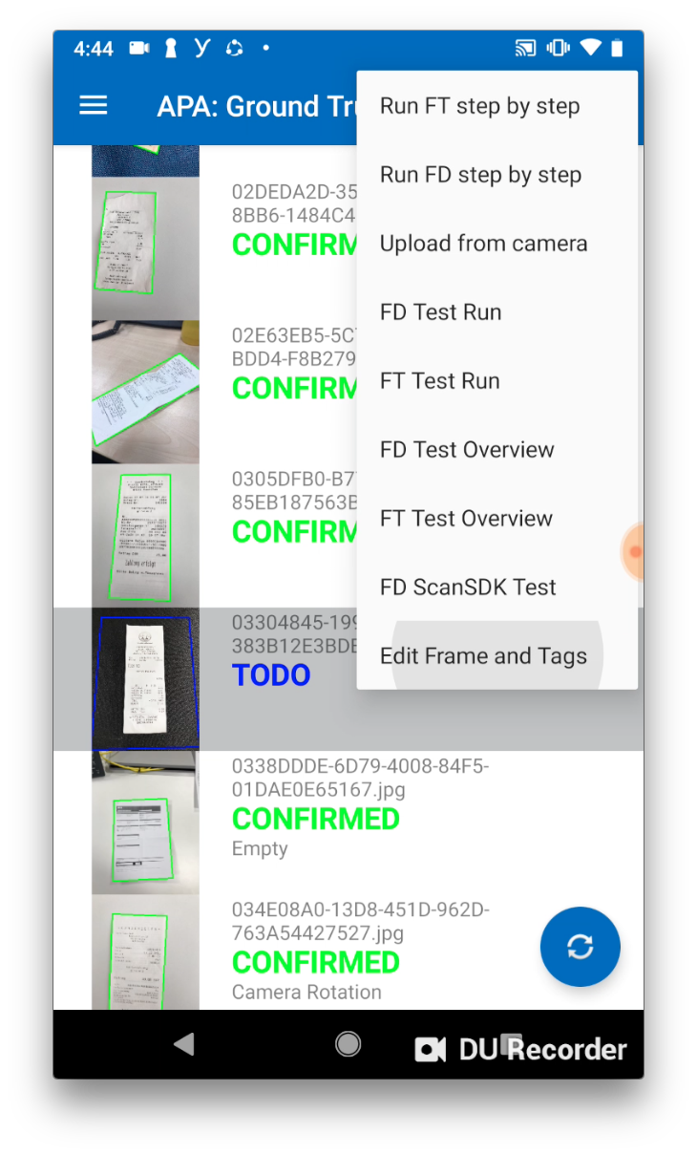
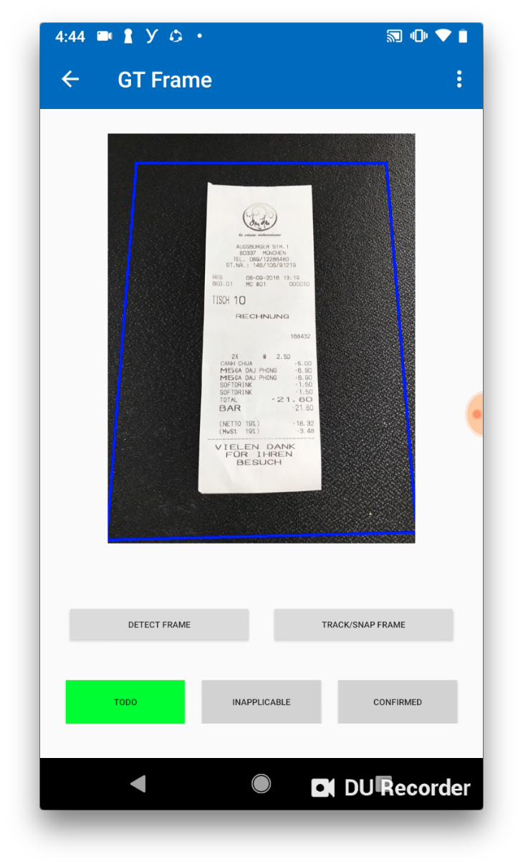
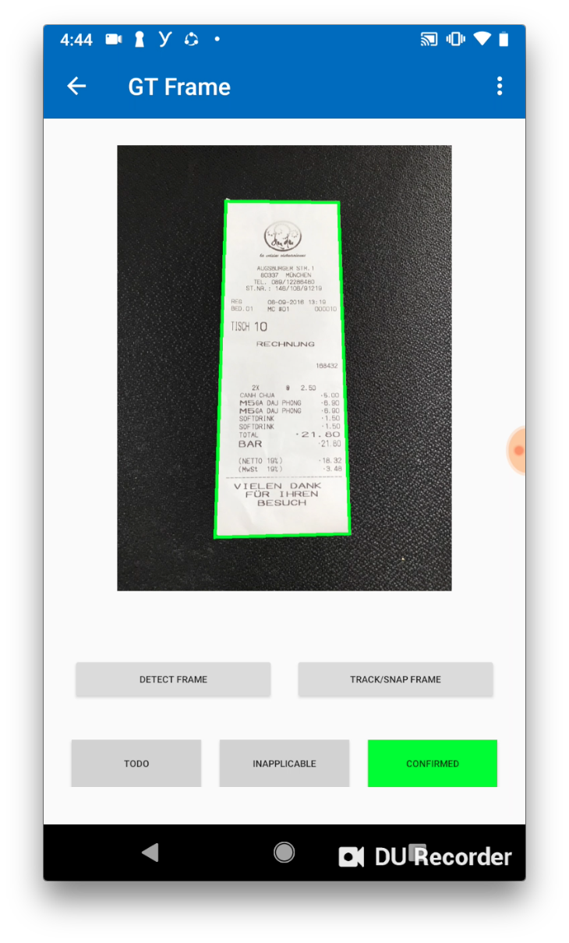
New data-driven solution
Data acquisition
Custom tool
take new photos
annotate frame for each photo
multiple users
AWS S3 bucket
Acquisition
2-3 people over a couple of days
952 pairs of photos and frames
265ced1609a17cf1a5979880a2ad364653895ae8
Notes:
To update the text, just click on the text
More slides with this layout: Copy slide and paste

Slide 10
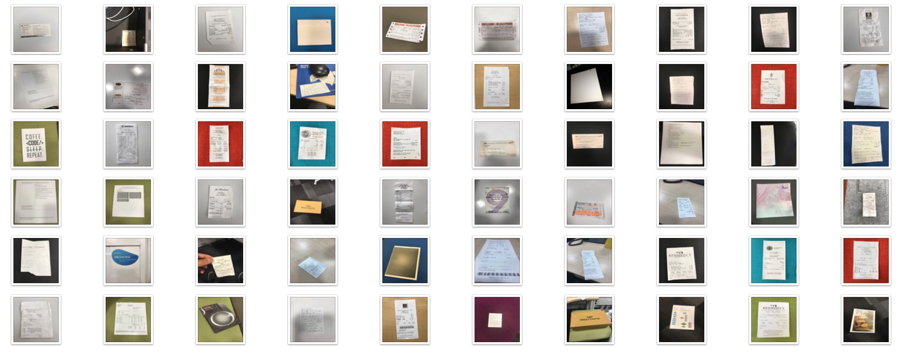
New data-driven solution
Data acquisition
Our training data:
(a small subset)
265ced1609a17cf1a5979880a2ad364653895ae8
Notes:
To update the text, just click on the text
More slides with this layout: Copy slide and paste

Slide 11
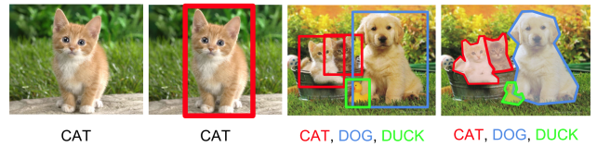
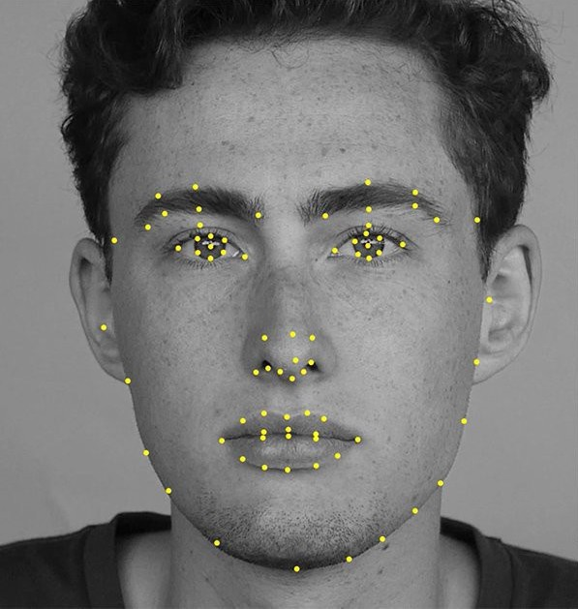
New data-driven solution
Finding a Machine Learning model for “frame detection”
Similar problem classes:
classification
classification +
localization
object
detection
instance
segmentation
landmark
detection
Image Source: https://leonardoaraujosantos.gitbooks.io/artificial-inteligence/content/object_localization_and_detection.html
265ced1609a17cf1a5979880a2ad364653895ae8
Notes:
To update the text, just click on the text
More slides with this layout: Copy slide and paste

Slide 12
New data-driven solution
Finding a Machine Learning model for “frame detection”
Similar problem classes:
Good match
more complicated
→ try next
Good match
simple formulation
→ try first
classification
classification +
localization
object
detection
instance
segmentation
landmark
detection
Image Source: https://leonardoaraujosantos.gitbooks.io/artificial-inteligence/content/object_localization_and_detection.html
265ced1609a17cf1a5979880a2ad364653895ae8
Notes:
To update the text, just click on the text
More slides with this layout: Copy slide and paste

Slide 13
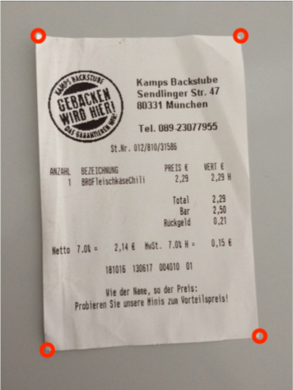
New data-driven solution
Landmark detection model
Model interface
“x”: the image
“y”: coordinates of the 4 corner points
model learns to compute y from x
e.g. 32×32 RGB
color image
e.g. 4×2 floats
0.30082 0.43197
-0.16771 0.41998
-0.39088 -0.43247
0.35591 -0.48487
265ced1609a17cf1a5979880a2ad364653895ae8
Notes:
To update the text, just click on the text
More slides with this layout: Copy slide and paste

Slide 14
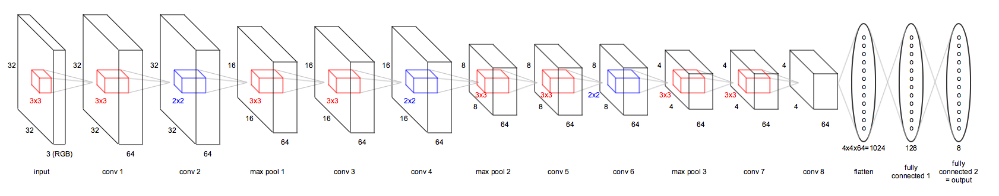
New data-driven solution
Landmark detection model
Model architecture
architecture inspired by VGG16/VGG19 (ImageNet ILSVRC-2014 winner)
convolutional + ReLU + max pooling at first
fully connected + ReLU + linear activation in the end (output length=4x2=8)
265ced1609a17cf1a5979880a2ad364653895ae8
Notes:
To update the text, just click on the text
More slides with this layout: Copy slide and paste

Slide 15
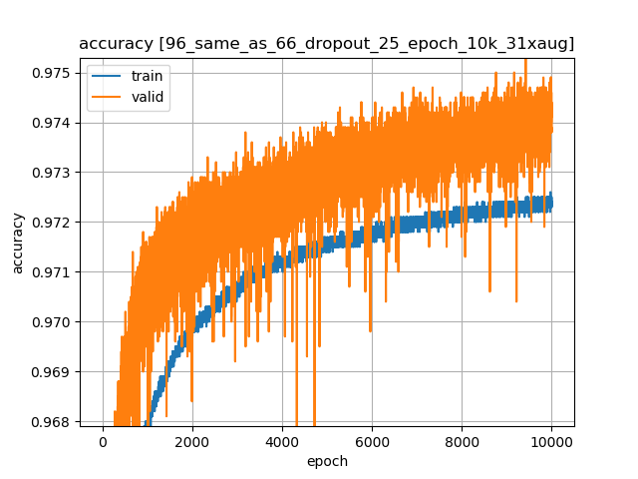
New data-driven solution
Landmark detection model
Training
Problems:
memory usage, computational complexity
accuracy
overfitting
Things we tried:
(CPU → GPU)
tune hyper-parameters (# of kernels, # of hidden units, image size)
regularization (using dropout)
data augmentation with random 3-D camera rotations applied on images and frames
Final result:
97.2% training accuracy
97.4% validation accuracy
1.3 MB model size
30fps on mobile
265ced1609a17cf1a5979880a2ad364653895ae8
Notes:
To update the text, just click on the text
More slides with this layout: Copy slide and paste

Slide 16
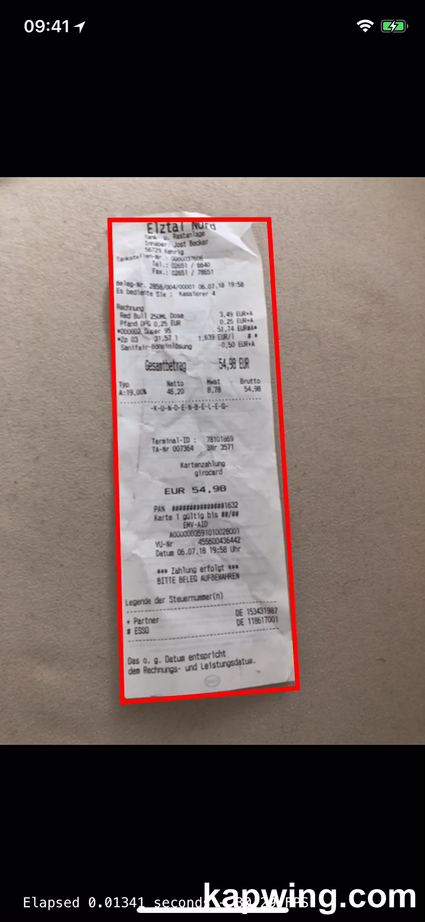
New data-driven solution
Landmark detection model
Demo video 1
accuracy of detecting a single document
transition from one document to another
265ced1609a17cf1a5979880a2ad364653895ae8
Notes:
To update the text, just click on the text
More slides with this layout: Copy slide and paste

Slide 17
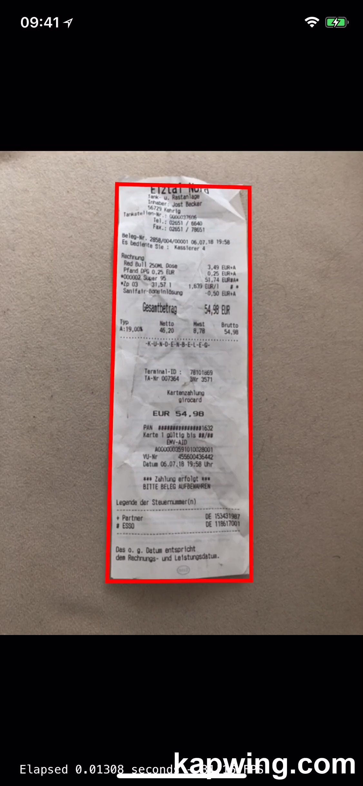
New data-driven solution
Landmark detection model
Demo video 2
accuracy of detecting a single document
partial occlusion of frame corners
265ced1609a17cf1a5979880a2ad364653895ae8
Notes:
To update the text, just click on the text
More slides with this layout: Copy slide and paste

Slide 18

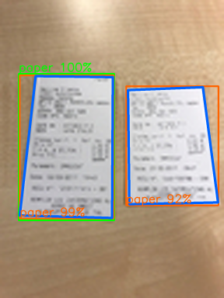
New data-driven solution
Object detection model (customized YOLOv2)
Model interface
“x”: the image
“y”: fixed-size “YOLO object detection layer”, is decoded into a list of object locations
model learns to compute y from x
e.g. 48×64 RGB
color image
e.g. 12×16×5×14 floats
[customized YOLO object detection layer
gives a variable-length list of
quadrilaterals]
265ced1609a17cf1a5979880a2ad364653895ae8
Notes:
To update the text, just click on the text
More slides with this layout: Copy slide and paste

Slide 19
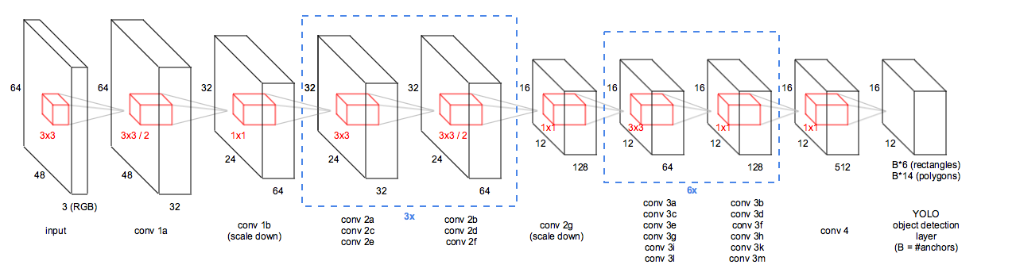
New data-driven solution
Object detection model (customized YOLOv2)
Model architecture
modification of YOLOv2
smaller image, less kernels, backend architecture first inspired by VGG16, later by SqueezeNet
extension of original YOLOv2 output, allows to detect polygons instead of rectangles
more grid cells per pixel
265ced1609a17cf1a5979880a2ad364653895ae8
Notes:
To update the text, just click on the text
More slides with this layout: Copy slide and paste

Slide 20
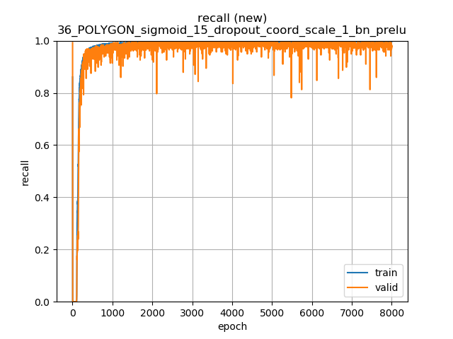
New data-driven solution
Object detection model (customized YOLOv2)
Training
Problems:
complicated architecture (custom loss function, custom accuracy)
accuracy
overfitting
Things we tried:
quite deep model (23 conv layers)
regularization (using dropout, batch norm.)
quite sophisticated data augmentation (training data contains no multiple document cases)
Final result:
99.7% training accuracy
98.0% validation accuracy
3 MB model size
30fps on mobile
265ced1609a17cf1a5979880a2ad364653895ae8
Notes:
To update the text, just click on the text
More slides with this layout: Copy slide and paste

Slide 21
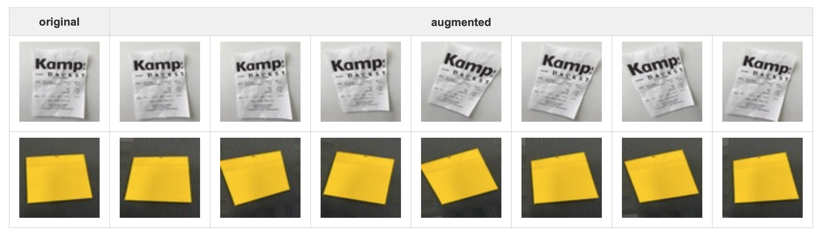
New data-driven solution
Augmentation strategy
Random camera pose
265ced1609a17cf1a5979880a2ad364653895ae8
Notes:
To update the text, just click on the text
More slides with this layout: Copy slide and paste

Slide 22
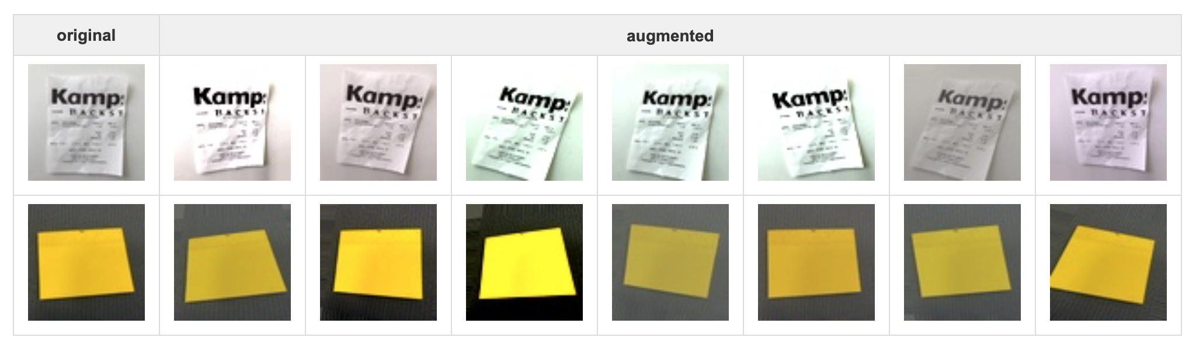
New data-driven solution
Augmentation strategy
Random camera pose + color changes
265ced1609a17cf1a5979880a2ad364653895ae8
Notes:
To update the text, just click on the text
More slides with this layout: Copy slide and paste

Slide 23
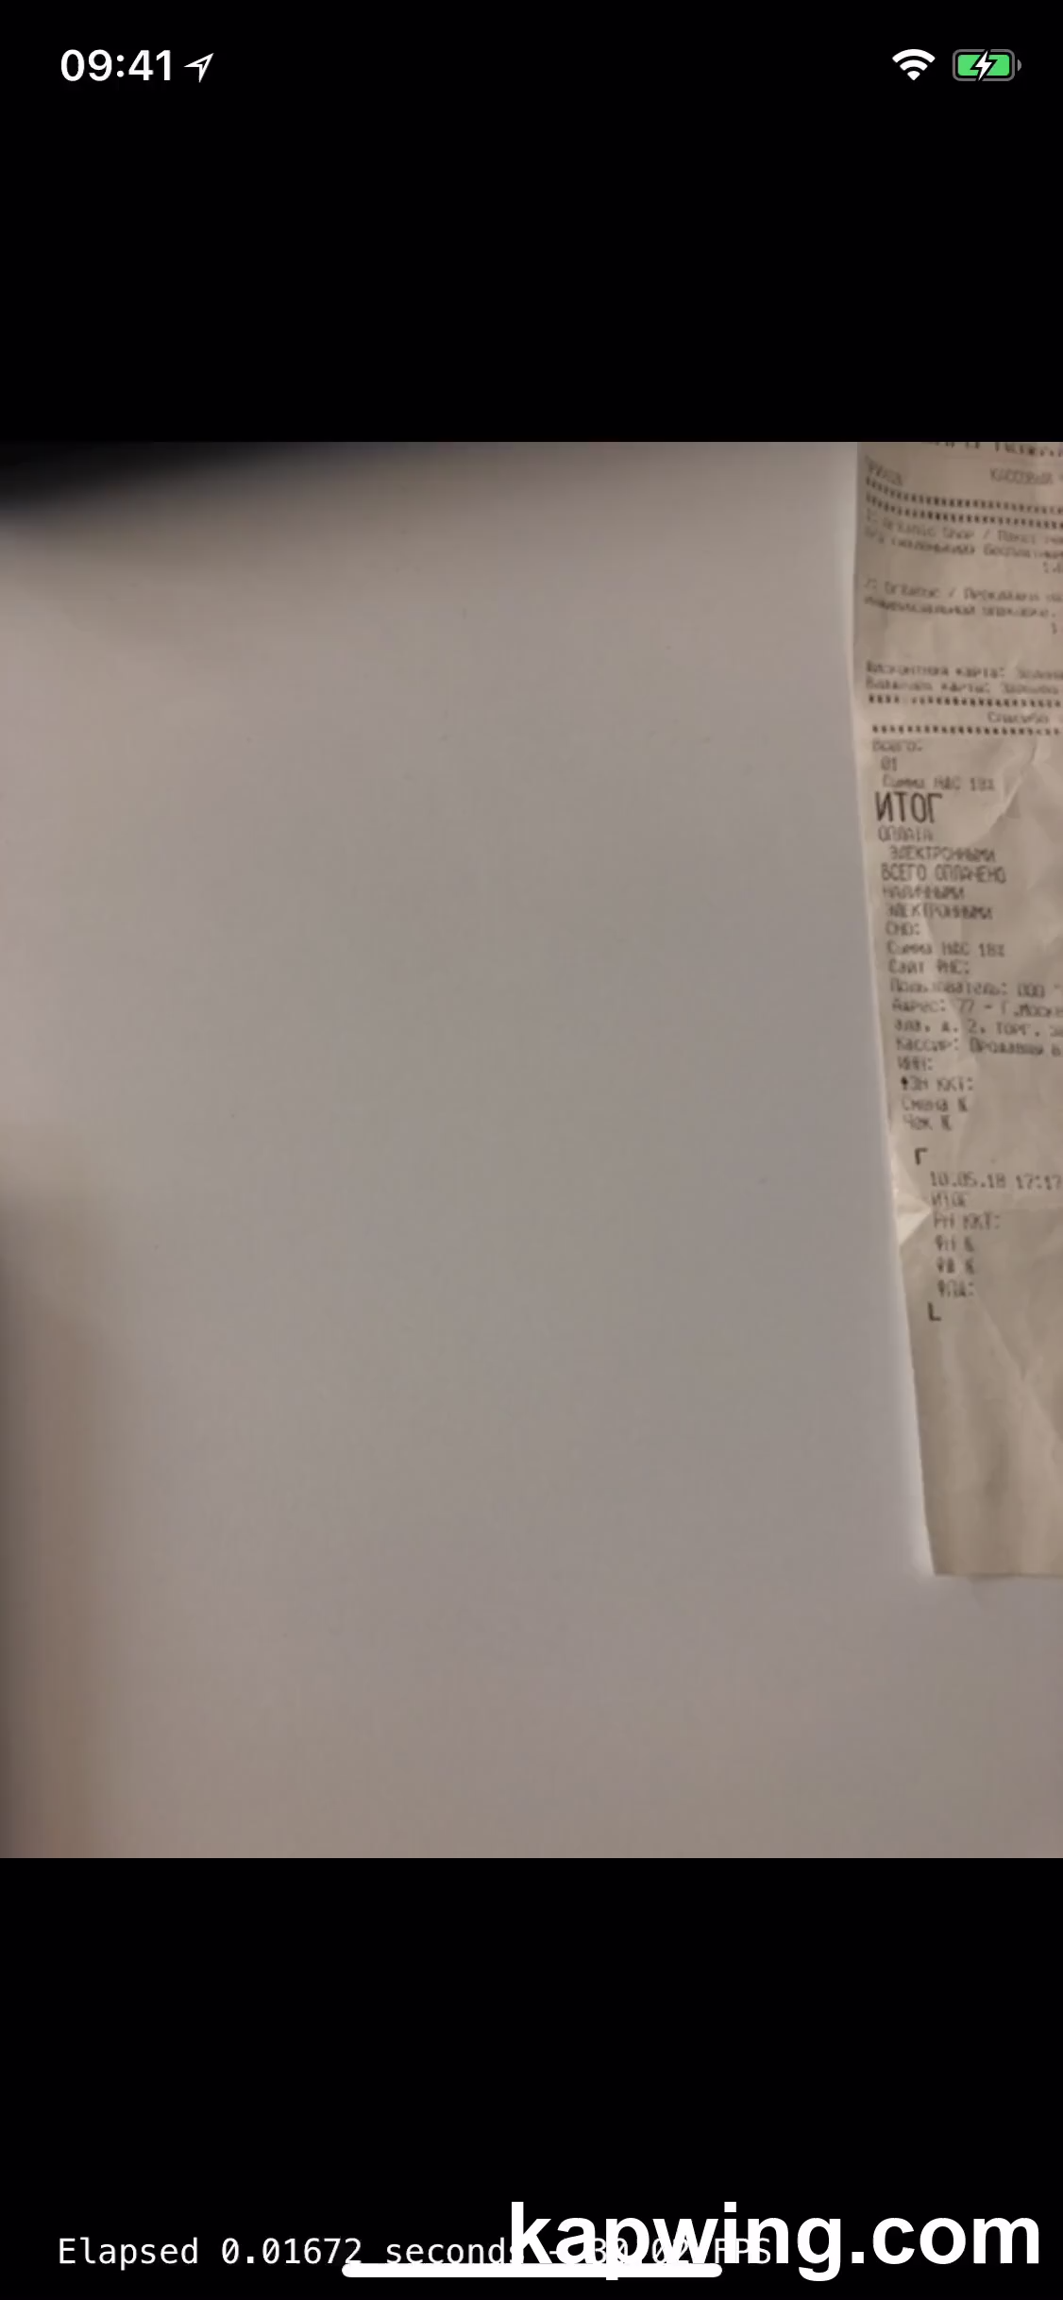
New data-driven solution
Object detection model (customized YOLOv2)
Demo video 1
accuracy of detecting multiple documents in parallel
almost the same computational complexity as compared to the landmark detection approach
265ced1609a17cf1a5979880a2ad364653895ae8
Notes:
To update the text, just click on the text
More slides with this layout: Copy slide and paste

Slide 24
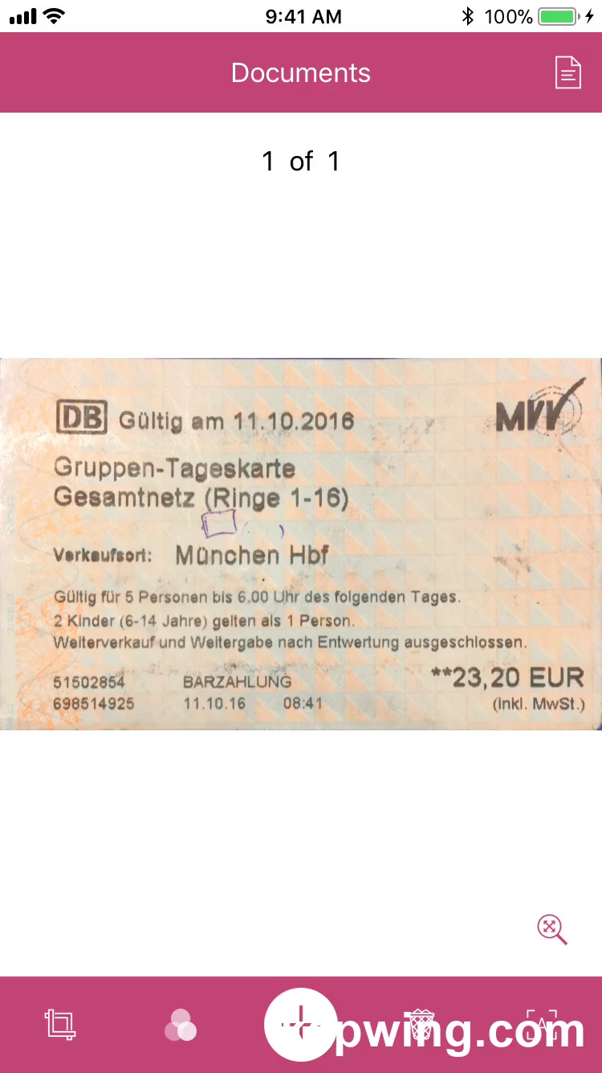
New data-driven solution
Object detection model (customized YOLOv2)
Demo video 2
integration into Expense Reader Scan SDK
265ced1609a17cf1a5979880a2ad364653895ae8
Notes:
To update the text, just click on the text
More slides with this layout: Copy slide and paste

Slide 25
New data-driven solution
Results
Time spent
2 months (vs 6 + 24 months for the earlier solutions)
gained valuable Machine Learning know-how along the way
Accuracy
roughly doubled to ~98%
practically solved
Implementation
model training is done in python
model integration is done in iOS and Android separately
very little platform-specific R&D work needed in iOS and Android
265ced1609a17cf1a5979880a2ad364653895ae8
Notes:
To update the text, just click on the text
More slides with this layout: Copy slide and paste

Slide 26
New data-driven solution
Next steps
Improve the model
same accuracy with less FLOPs
handle low light and other special situations
Use image data from actual customers
~3000 new images per week (as compared to original <1000 training images)
infrastructure almost ready
Apply Machine Learning approach to other problems within Amadeus
currently doing right that, we’re reworking the Expense Reader API’s extraction part
265ced1609a17cf1a5979880a2ad364653895ae8
Notes:
To update the text, just click on the text
More slides with this layout: Copy slide and paste

Slide 27
Thank you!
amadeus.com Amadeus.com/blog
You can follow us on:
AmadeusITgroup
265ced1609a17cf1a5979880a2ad364653895ae8
Notes:
Backcover option 1

